Slide 1
Forecasting Stroke Recovery
Wearable-monitored prediction of arm function recovery in stroke patients
Valerio Gomez-Frittelli
Undergraduate, Statistics and Machine Learning

Slide 2
Background
Stroke leaves survivors with variable arm impairments, which can make rehabilitation difficult (Raghavan). Physicians may decide to adjust or continue the current treatment depending on how well patients seem to be recovering, but frequent clinical visits can be a burden on patients.
Remote monitoring of patients using wearables can be a great help to both parties. It gives physicians constant data about patients’ recovery while reducing the burden on patients by reducing the frequency of clinical visits (Demers et al).

Slide 3
The Problem
Stroke treatment is reactive
Even with remote monitoring, doctors need to wait for clear change to evaluate treatment.
Rehabilitation can feel slow or ineffective if weeks of treatment result in little recovery and a change in treatment.

Slide 4
Project Goal
We aim to forecast patient recovery using data from wearable sensors.

Slide 5
Relevance
Fast Feedback
Warning Signs
With reliable forecasting, physicians could optimize treatment with less trial and error and patient burden.
With a sensitive enough model, patients showing signs of backsliding could be identified as being at risk of decline.

Slide 6
Forecasting Needs
Sequential
Online
Reliable
Data are time series.
Final model must respect the temporal axis.
We want a model that will update automatically as new data is collected.
We need to reliably forecast recovery for real-world relevance.

Slide 7
Possible Models
A few models that may serve:
Autoregressive Integrated Moving Average (ARIMA)
Exponential Smoothing (ETS)
Recurrent Neural Network (RNN)
The first two of these models are statistical, while RNN brings in machine learning. RNN is potentially more powerful, but also more difficult to apply, since it needs
a lot of data to avoid overfitting.

Slide 8
Current Models
ETS and ARIMA are not too difficult to fit, and set the bar that more complex models will need to beat to be worthwhile.

Slide 9
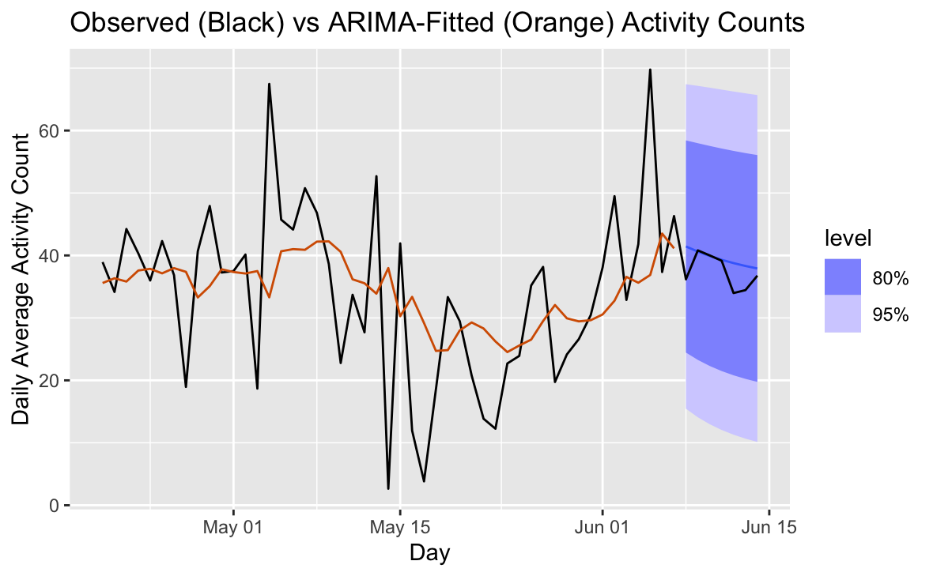
ARIMA
ARIMA draws a smooth trend line, treating much of the variation in data as noise. This conservative approach avoids large errors, but does not capture all the interesting variation we would like to model.
Notes:
Core idea: flexibility between autoregressive forecast (linear comb. of previous obs) or moving average forecast (comb. of prediction errors)

Slide 10
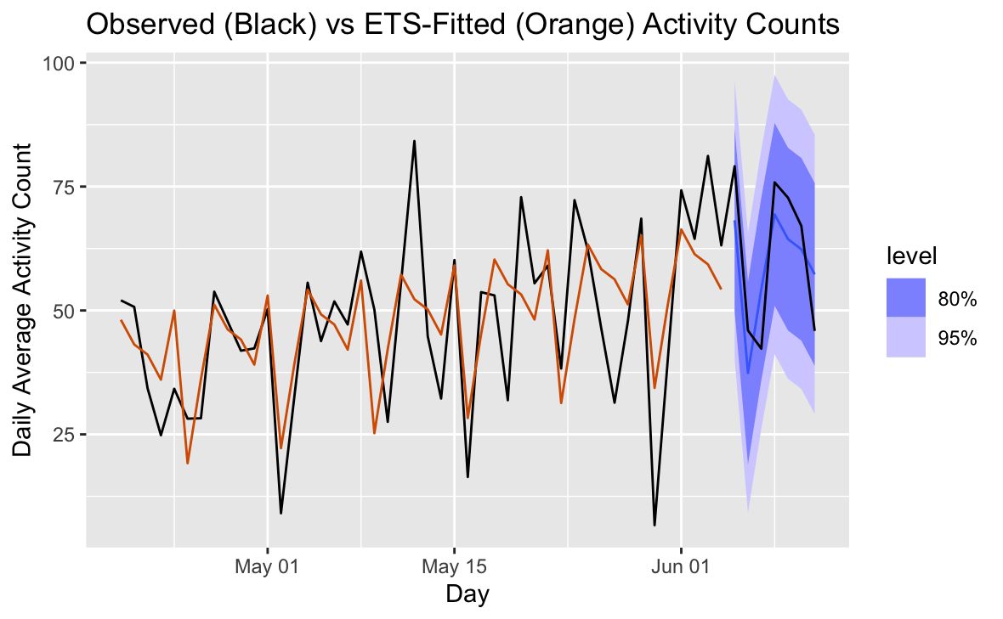
Exponential Smoothing
ETS makes a stronger attempt to replicate the seasonal patterns in the data. Its predictions look more realistically shaped than ARIMA’s, but bad guesses are not uncommon, and can give greater error.
Notes:
Core idea: compute weighted moving average with weights that exponentially decay for older observations

Slide 11
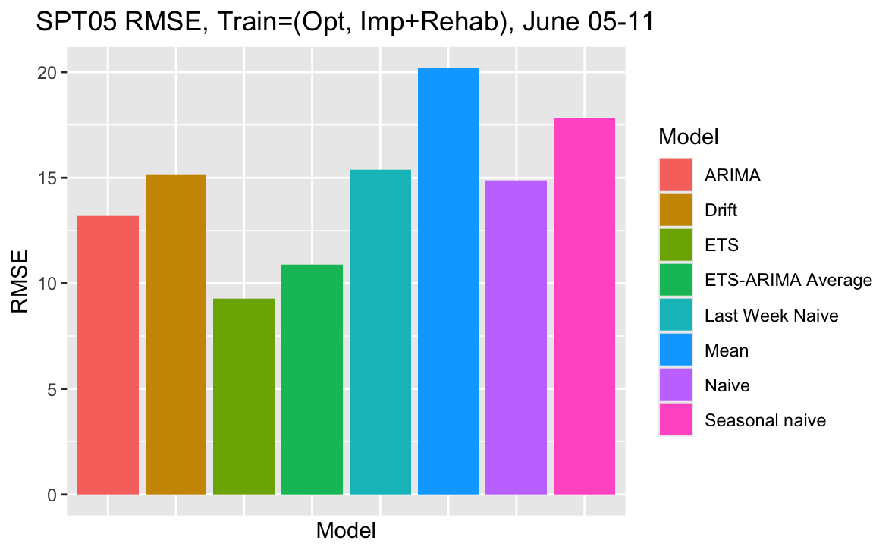
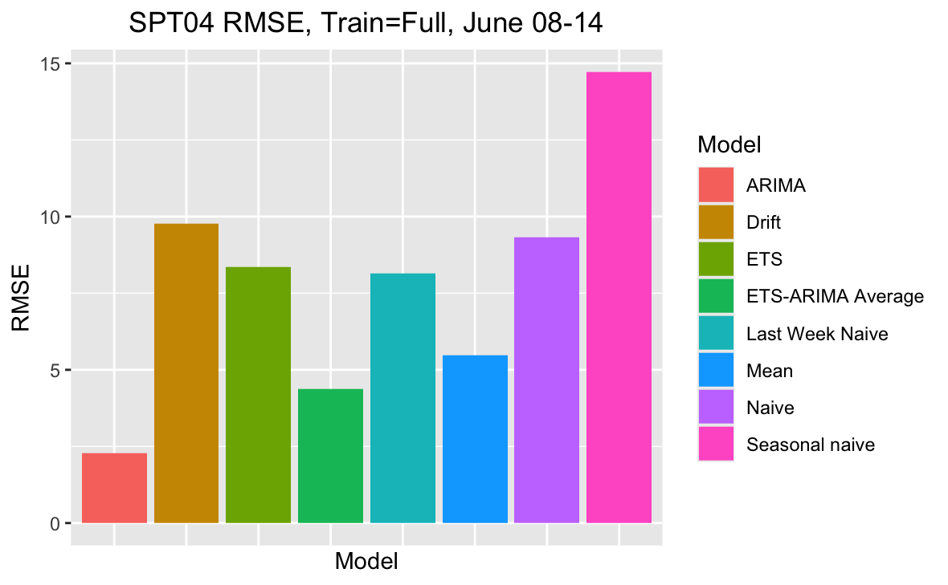
Statistical models beat baselines
ETS
ARIMA
For both participants, one or both of ETS or ARIMA beat all simple baseline prediction methods.
This confirms that we can do better than guessing.

Slide 12
Timeline
Early May
Late May
Early June
Now
Onboarding
Data exploration
Model search
Simple models
Fitting statistical models
Evaluating statistical models
Next Steps
July
August
Beyond
Begin fitting more complex models
Adapt and evaluate complex models
Final model selection
Continue forecasts with final model

Slide 13
Sources Cited
Arm Function Deficits | Raghavan, Preeti. “Upper Limb Motor Impairment After Stroke.” Physical medicine and rehabilitation clinics of North America vol. 26,4 (2015): 599-610. doi:10.1016/j.pmr.2015.06.008
Wearable Monitoring | Marika Demers, Lauri Bishop, Amelia Cain, Joseph Saba, Justin Rowe, Daniel K Zondervan, Carolee J Winstein, Wearable Technology to Capture Arm Use of People With Stroke in Home and Community Settings: Feasibility and Early Insights on Motor Performance, Physical Therapy, Volume 104, Issue 2, February 2024, pzad172, https://doi.org/10.1093/ptj/pzad172

Slide 14
Thanks!

